Slide 1

DIABETES PREDICTION USING
MACHINE LEARNING
KARTIK PARMAR 22106101
NIRAJ PATEL 22106050
JAY PATIL 22106020
PRATHAM PATANGE 22106045
Project Guide
Prof KANCHAN WANKHEDE

Slide 2
Outline
Introduction
Limitations of the Existing Systems
Problem Statement
Proposed System Design
Framework/Algorithm
Technologies Stack for Proposed System
Details of Database / Input to the System
Implementation
Conclusion
References

Slide 3
INTRODUCTION:
Diabetes is a chronic disease that affects millions of people worldwide. Early detection and diagnosis are crucial for preventing complications and improving patient outcomes.
Prediction systems utilize machine learning algorithms to analyze patient data and identify individuals at risk for developing diabetes.
The systems offer several benefits, including early intervention, improved patient management, and reduced healthcare costs.

Slide 4
MOTIVATION:
Diabetes is a growing global health concern, affecting millions of people worldwide.
Early detection and diagnosis of diabetes are crucial for preventing its complications and improving patient outcomes.
Developing accurate and efficient diabetes prediction systems can aid healthcare professionals in identifying individuals at risk for developing the disease.

Slide 5
OBJECTIVES:
To develop an ML-based model for the early prediction of diabetes, utilizing diverse data inputs such as clinical, genetic, and lifestyle factors to enhance prediction accuracy.
To compare the performance of various machine learning algorithms in predicting diabetes risk.
To create a user-friendly tool that can be used by healthcare providers and individuals for real-time risk assessment.
To address the gaps in early detection by focusing on predictive accuracy and personalization.

Slide 6
LITERATURE SURVEY:
Prediction of diabetes using classification algorithms published in : Procedia computer science 132 (2018), Diabetes is considered as one of the deadliest and chronic diseases which causes an increase in blood sugar. Many complications occur if diabetes remains untreated and unidentified. The tedious identifying process results in visiting of a patient to a diagnostic center and consulting doctor. But the rise in machine learning approaches solves this critical problem.
Comparison of accuracy level of support vector machine (SVM) and artificial neural network (ANN) algorithms in predicting diabetes mellitus disease published in: ICIC Express Letters 15.1 (2021),Many studies have stated that obesity is one of the risk factors that cause type 2 Diabetes Mellitus. World Population Data Sheet 2017 revealed that there were 7.5 billion people in the world. The highest number of people with diabetes was between the ages of 40 and 59 years.
Classification Of Diabetes Disease Using Support Vector Machine published in : (2015), The proposed method uses Support Vector Machine (SVM), a machine learning method as the classifier for diagnosis of diabetes. The machine learning method focus on classifying diabetes disease from high dimensional medical dataset. The experimental results obtained show that support vector machine can be successfully used for diagnosing diabetes disease.

Slide 7
Diabetes Prediction Using Machine Learning Algorithms and Ontology published in : Journal of ICT Standardization, vol. 10, no. 2, pp. 319-337, (2022), Various types of classification algorithms were considered namely: SVM, KNN, ANN, Naive Bayes, Logistic regression, and Decision Tree. The experimental results showed that the best accuracy goes for ontology classifiers and SVM.
Prevalence and early prediction of diabetes using machine learning in North Kashmir published in: Computational Intelligence and Neuroscience ,(2022), To evaluate how well the algorithms worked in Pima Indian data collection was used. The accuracy that was achieved using 10-fold cross-validation was 77.86 percent across the five algorithms (neural network, SVM, DTM, LR, and Naive Bayes) that were used.

Slide 8
LIMITATIONS OF EXISTING SYSTEMS:
Data Quality: Imbalanced Datasets: Many datasets used for diabetes prediction are often imbalanced, with fewer positive cases of diabetes compared to negative ones. This can lead to biased models that perform poorly in identifying true positive cases (diabetes patients).
Availability of data: Small Sample Sizes: Many datasets available for training models are relatively small, limiting the model's ability to generalize well on larger populations.
Lack of Feedback: Most earlier diabetes prediction models focus solely on predicting the risk of diabetes or blood sugar levels without offering practical steps to manage or reduce risk. This makes it harder for users to take immediate action.
No Direct Connection to Healthcare Providers: Users who receive a diabetes risk assessment or blood sugar alert in previous models are often left with no immediate guidance on where to seek medical help.

Slide 9
PROBLEM STATEMENT
Develop a machine learning model using a Support Vector Machine (SVM) to predict whether an individual has diabetes based on medical diagnostic measurements from the Indian Diabetes dataset, aiming to assist healthcare professionals in early diabetes detection and management.

Slide 10
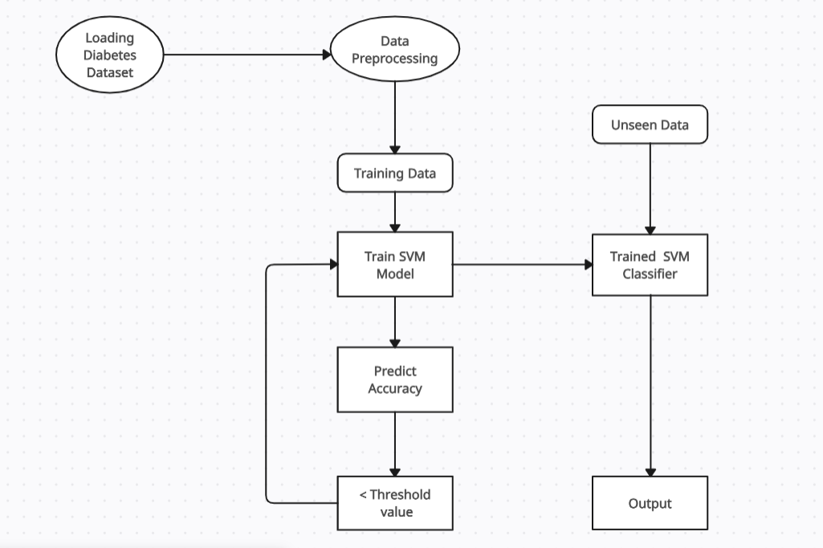
PROPOSED SYSTEM DESIGN

Slide 11
FRAMEWORK/ALGORITHM
1. Data Loading: - The Pima Indian Diabetes dataset is loaded using pandas, and the initial exploratory data analysis is conducted by checking the dataset's shape, basic statistics, and distribution of the target variable (Outcome).
2. Data Preprocessing: - The dataset is standardized using Standard Scaler from scikit-learn to normalize the features . The features are separated from the target variable, which indicates whether a person is diabetic.
3. Train-Test Split: - The dataset is split into training and testing sets using an 80-20 split to evaluate the model's performance. Stratification is used to ensure that the distribution of the target variable is consistent across training and testing sets.
4. Model Training: - A Support Vector Machine (SVM) classifier with a non-linear kernel is trained on the training set.

Slide 12
TECHNOLOGY STACK FOR PROPOSED SYSTEM
1.Programming Language
Python
2.Libraries and Frameworks
NumPy
Pandas
scikit-learn (sklearn)
streamlit
3.Database
Mongo DB

Slide 13
DETAILS OF DATABASE / INPUT TO THE SYSTEM
The diabetes dataset that has been used contains the following inputs :
gender: The biological sex of the individual (Male/Female).
age: Age of the individual in years.
hypertension: Whether the individual has hypertension (1 for yes, 0 for no).
heart_disease: Whether the individual has a history of heart disease (1 for yes, 0 for no).
smoking_history: The smoking status of the individual (e.g., current, never, No Info).
bmi: Body Mass Index, a measure of body fat based on height and weight (kg/m²).
HbA1c_level: Glycated hemoglobin level, an indicator of blood sugar levels over the past 2-3 months.
blood_glucose_level: Current level of glucose in the blood (mg/dL).
diabetes: Outcome variable indicating if the individual has diabetes (1 for yes, 0 for no).

Slide 14
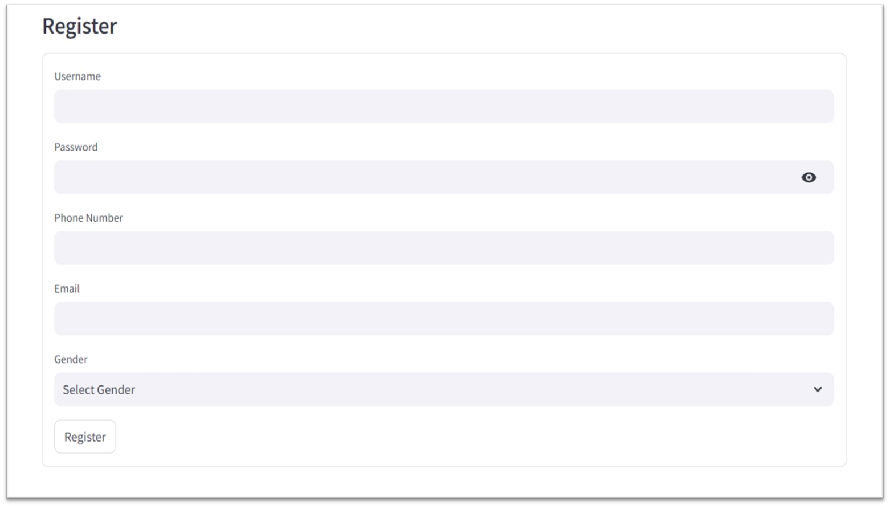
IMPLEMENTATION(SCREENSHOTS OF IMPLEMENTATION)
Fig 5.3.1 Register Page

Slide 15
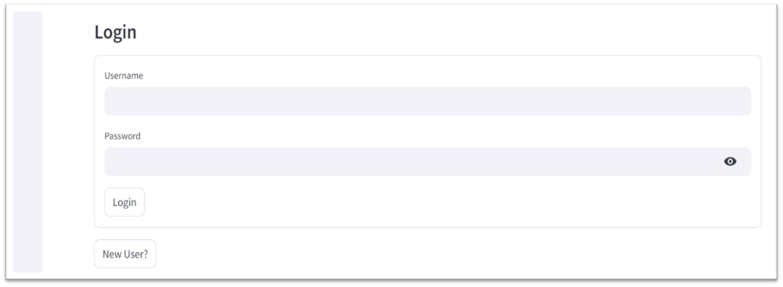
Fig 5.3.2 Login Page

Slide 16
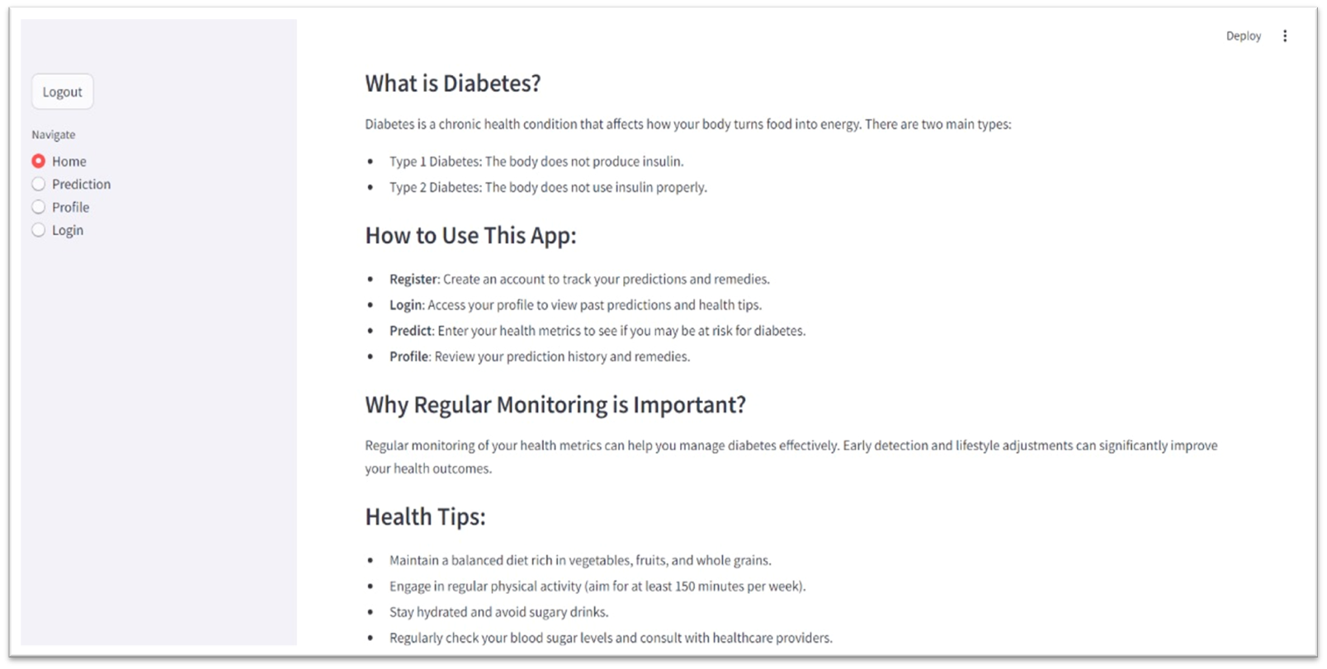
Fig 5.3.3 Home Page

Slide 17
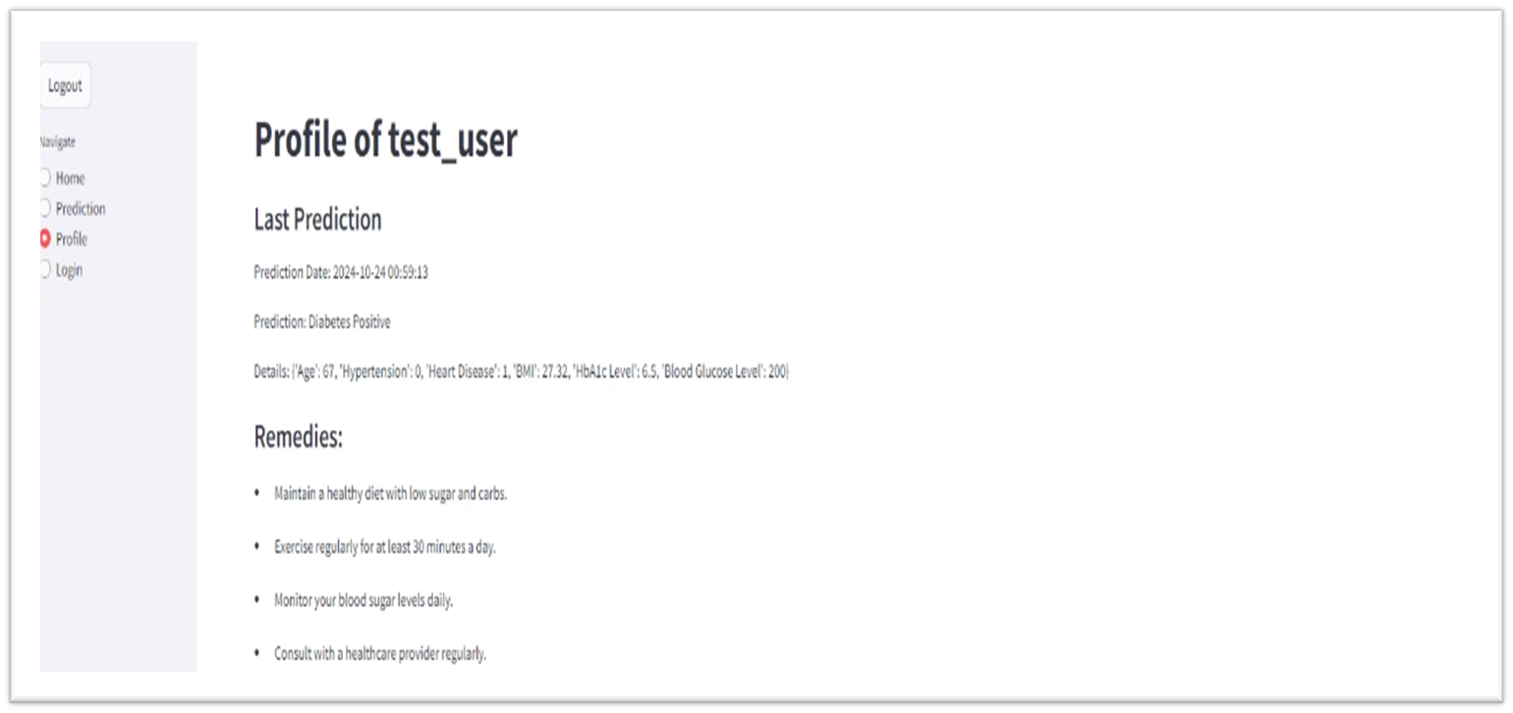
Fig 5.3.4 Profile Page

Slide 18
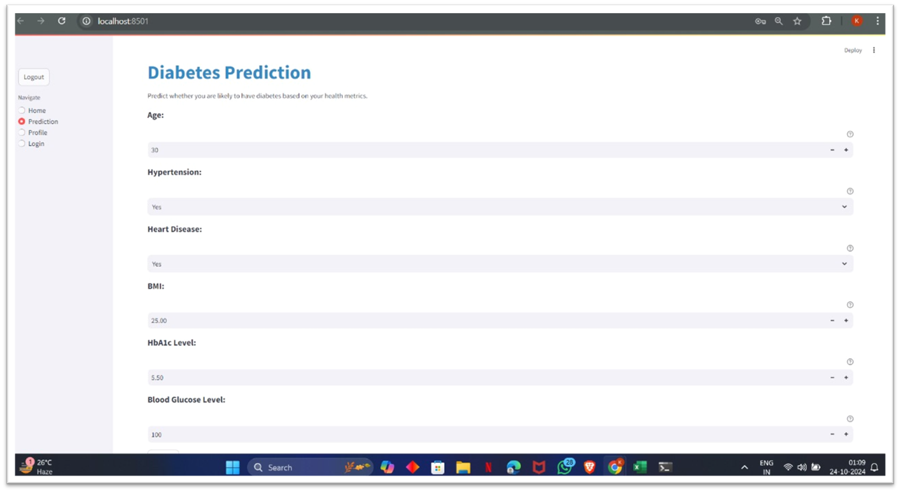
Fig 5.3.5 Prediction Page

Slide 19
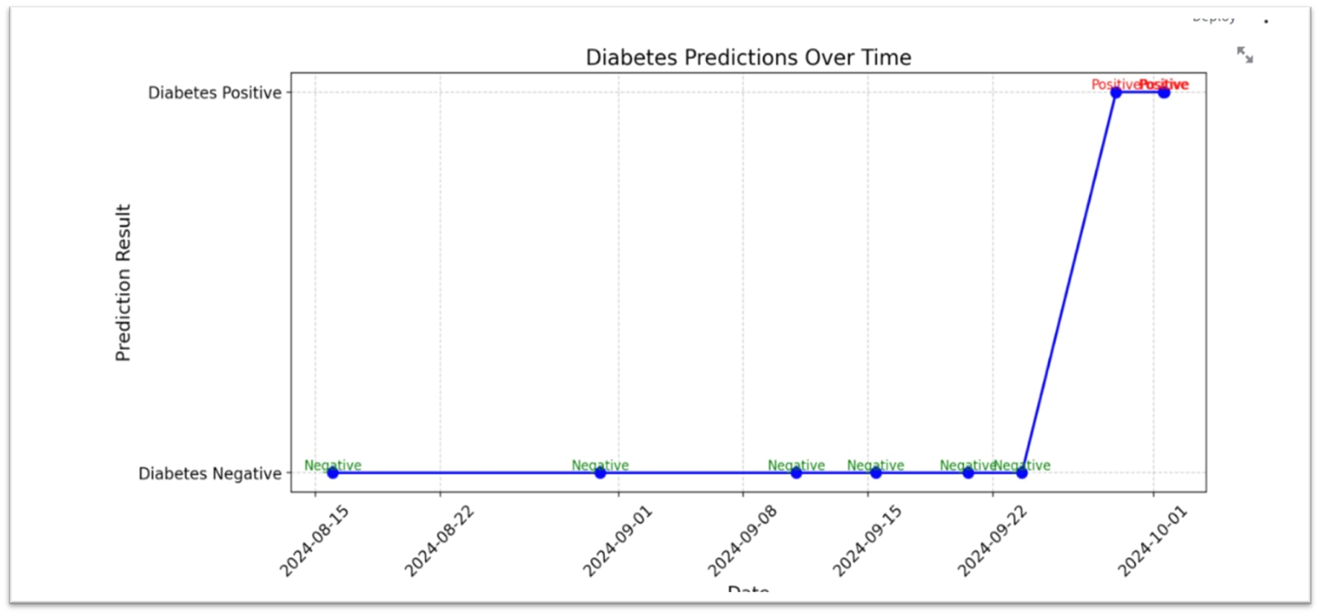
Fig 5.3.6 Prediction Graph

Slide 20
CONCLUSION
In conclusion, we have successfully trained a machine learning model using a Support Vector Machine (SVM) classifier to predict diabetes based on the Indian Diabetes dataset , including data preprocessing, model training, and evaluation, is fully prepared and demonstrates promising accuracy in predicting diabetes cases.

Slide 21
REFERENCES
[1] Sisodia, Deepti, and Dilip Singh Sisodia. "Prediction of diabetes using classification algorithms." Procedia computer science 132 (2018): 1578-1585.
[2] Anggoro, Dimas Aryo, and Dian Novitaningrum. "Comparison of accuracy level of support vector machine (SVM) and artificial neural network (ANN) algorithms in predicting diabetes mellitus disease." ICIC Express Letters 15.1 (2021): 9-18.
[3] Classification Of Diabetes Disease Using Support Vector Machine V. Anuja Kumari, R.Chitra (2015).
[4] H. E. Massari, Z. Sabouri, S. Mhammedi and N. Gherabi, "Diabetes Prediction Using Machine Learning Algorithms and Ontology," in Journal of ICT Standardization, vol. 10, no. 2, pp. 319-337, 2022, doi: 10.13052/jicts2245-800X.10212.
[5] Bhat, Salliah Shafi, Venkatesan Selvam, Gufran Ahmad Ansari, Mohd Dilshad Ansari, and Md Habibur Rahman. "Prevalence and early prediction of diabetes using machine learning in North Kashmir: a case study of district bandipora." Computational Intelligence and Neuroscience 2022, no. 1 (2022): 2789760.

Slide 22
Thank You...!!

